Slide 1
Movie Performance Based on Script
Jeff Wilburn, Data Scientist

Slide 2
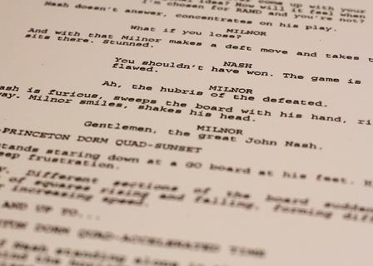
What in a movie script?
A movie script or screenplay is the written story and dialogue pre-production.
Often viewed as the original blueprint for a movie
The format for a screenplay is a highly structured format
1” top and bottom headers
12 point courier font
Scene headings and character names are fully capitalized
Character dialog is centered
General rule of thumb: one page is about 1 minute, comedies tend to be about 90 min(pages) and dramas tend to be closer to 120 min (pages)

Slide 3
Scripts by the Numbers
Based on best estimates “there are approximately one million people worldwide trying to write scripts. ” - Corey Mandell “Script” a division of Writer’s Digest
In 2011, 50,000 scripts were registered with the WGA
In 2016, 736 movies were theatrically released, but only 93 studio (6 players: Warners, Disney, Fox, Paramount, Sony and Universal and on at least 1,000 cinemas) were made *
That’s a lot of scripts that need to be sorted through to make a small number of movies!

Slide 4
Problem:
“Information gathered from a variety of sources indicate the average producer gets at least 10,000 scripts a year, many of which do not get read. They are more likely to reach the recycle bin before they ever get into a reader’s hands.” – Dennis Evano, CEO Trans Media Productions
Could there be a way to parse through scripts and determine with any certainty if the underlying words in a script could determine it’s success?
Could this be streamlined for the movie industry?

Slide 5
Scraped IMSDB for Scripts
Created a list of titles
Used titles to Scrape TMDB API for movie info
Created a list TMDB Movie IDs
Used Movie IDs to Scrape TMDB API for FULL movie info
Created a list of IMDB Movie IDs
Used IMDB Movie IDS to scrap IMDB
Created a list of IMDB Movie Ratings

Slide 6
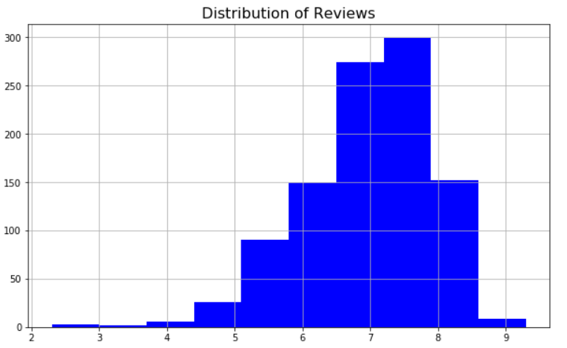
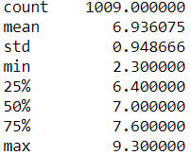
Predicting Viewer Ratings
Average viewer rating for out of 10 (stars)
For scripts scaped: 6.94
Highest Rating: 9.3 (“Shawshank Redemption” with Tim Robbins and Morgan Freeman)
Lowest Rated: 2.3 (“Alone in the Dark” with Christian Slater and Tara Reid)
For All movies on IMDB: 6.39 (17,845 movies with over 1000 ratings)*

Slide 7
CountVectorizing and TF-IDF
Used stopwords = “english”
Lastly removed all floats/numbers from the corpuses as well
Tested various min_df and max_df parameters
As well as ngram sizes
In general, used min_df 10% and max_df 90% to removal the distinct character names on the low end as well as any words that would essentially be categorized as stop words.

Slide 8
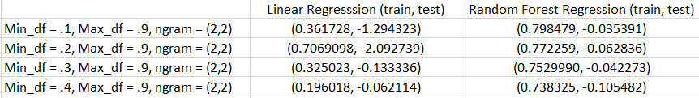


Linear Regression and Random Forest Regression
After CountVectorizing and TF-IDF, fit and scored on these two models…. To no avail,

Slide 9




Logistic Regression and Random Forest Regression
Financial success classifier = (Revenue – Budget) > $20M
545 Successful, 464 Unsuccessful
Critical success classifier = (Number of Stars > Mean Star Value
541 Successful, 468 Unsuccessful

Slide 10
Conclusions
Unlike books words are not the only thing that makes a movie successful
Many other variables come into play: directing, editing, acting, marketing budget, etc, etc,
These models would be really interesting to test on scripts that were passed on as well.
Next, would love to look at the scripts for the Hollywood blacklist

Slide 11
Citations
Author, Stephen Follows, Article: “How many films are released each year?” August 14, 2017
Author, Lonzo Peroni, “What is an average rating on IMDB for a movie?”

